Slide 1
*qqq
EGB1201 – JAVA PROGRAMMING
FINAL REVIEW
Department of Electrical and Electronics Engineering
Academic Year: 2025 – 2026 (Odd Semester)
Register Number :927624BEE024
Name :DHIVYALAKSHMI B R
Year :II
Semester :III
Section :A
Date :13/12/2025

Slide 2
Title of the Project
CURRENCY CONVERTOR APPLICATION

Slide 3
Abstract
This project implements a currency converter system that allows users to convert amounts between different currencies using real-time exchange rates. It features simple input, instant conversion, and optional offline support. Beyond basic conversion, it includes multi-currency conversion, historical rate visualization, making currency management more efficient and user-friendly.

Slide 4
Abstract with CO/PO Mapping
Abstract | CO | POs | PSO
This project is a simple currency converter that allows users to convert money from one country’s currency to another easily. It helps people know the current value of different currencies instantly. The system takes an amount as input and quickly displays the converted value, making it convenient for travel, business, or daily use. Designed with a clear and user-friendly interface, this project makes currency conversion faster, easier, and more accurate for everyone. | CO1 CO2 CO3 CO4 | PO1 PO2 PO3 PO4 PO5 PO6 PO7 PO8 PO9 PO10 PO11 PO12 | PSO1 PSO2

Slide 5
Introduction
The Currency Converter Application is a Java-based software system developed to help users convert amounts between multiple currencies quickly and accurately. By connecting to real-time exchange rate APIs, it ensures up-to-date and precise conversions. The application features a simple, user-friendly interface that makes it easy for users to input values, select currencies, and view instant results. It also demonstrates the effective use of Java programming concepts such as API integration, event handling, and interface design. Overall, this project provides a practical and efficient solution for users needing quick and accurate currency conversions in their daily financial tasks.

Slide 6
Java Programming - Concepts Used
The Currency Converter system was equipped with several foundational features. It supported basic currency conversion, wherein users could enter an amount, select the source and target currencies, and obtain the converted value instantly. To maintain accuracy, the system retrieved real-time exchange rates through external APIs. Additionally, it facilitated multi-currency conversion, enabling a single amount to be simultaneously converted into multiple currencies. The system also incorporated offline conversion capabilities by utilizing cached rates in the absence of internet connectivity. Furthermore, its user-friendly interface—comprising menus for currency selection, input fields, conversion controls, and clear result displays—ensured a seamless and convenient user experience.

Slide 7
Proposed Architecture
The upgraded Currency Converter System is built on a layered architecture that integrates the user interface, processing, and data management modules. It supports real-time conversions using live exchange rate APIs and provides historical rate visualization to help users analyze currency trends. The multi-currency conversion module that allows quick conversions for multiple currencies at once. This architecture ensures accuracy, speed, and a smooth user experience for efficient currency management.

Slide 8
Proposed Architecture - Description
1. Historical Rate Visualization
Shows past exchange rate trends through charts, helping users analyze fluctuations and make smarter financial decisions.
2. Predictive Analytics
Uses historical data to forecast future rates and suggests the best time for conversions, reducing guesswork.

Slide 9
Proposed Architecture - Description (Cont..)
3. Quick conversion using Real-time data
Fetches Real time data from trustable API’s to give the most efficient data.
4. Multi-Currency Batch Conversion
Allows one amount to be converted into multiple currencies at once, saving time for travelers and businesses.

Slide 10
List of Modules
User Interface Module
Processing Module
API Integration Module
Data Management Module
Conversion Result Module

Slide 11
Module Description
1. User Interface Module
This module allows users to enter the amount, choose source and target currencies, and view conversion results through a simple and interactive interface.
2. Processing Module
It performs the main conversion logic by processing user input and applying the correct exchange rate to generate accurate results.
3. API Integration Module
This module connects the system to real-time exchange rate APIs, ensuring that the conversion uses the most updated and accurate rates.

Slide 12
Module Description (Cont..)
4. Data Management Module
It stores cached exchange rate data for offline access and maintains historical rate information for analysis and trend visualization.
5. Conversion Result Module
This module displays the converted amount, along with rate details and other related information, in an organized and user-friendly format.

Slide 13
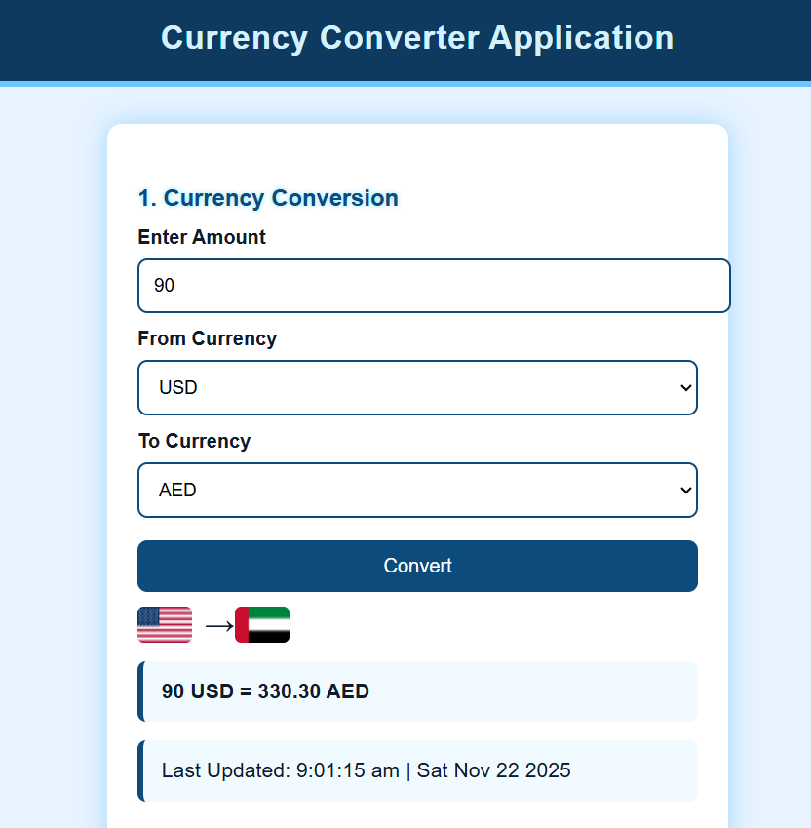
Results and Discussion

Slide 14
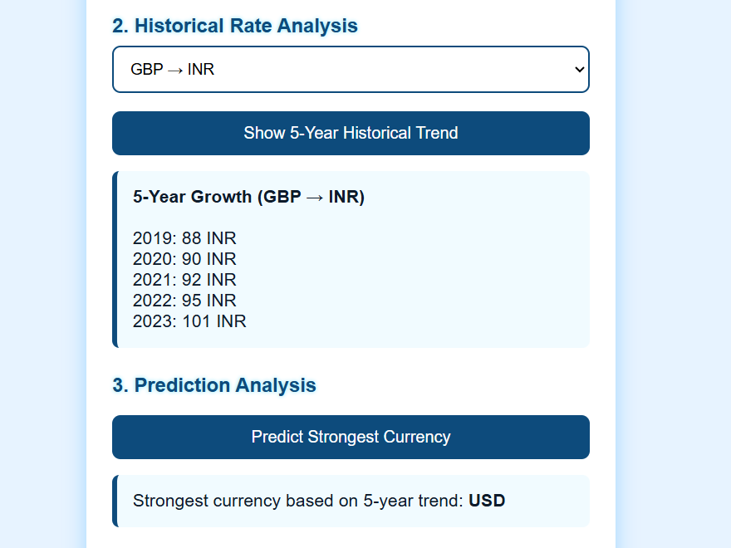
Results and Discussion

Slide 15
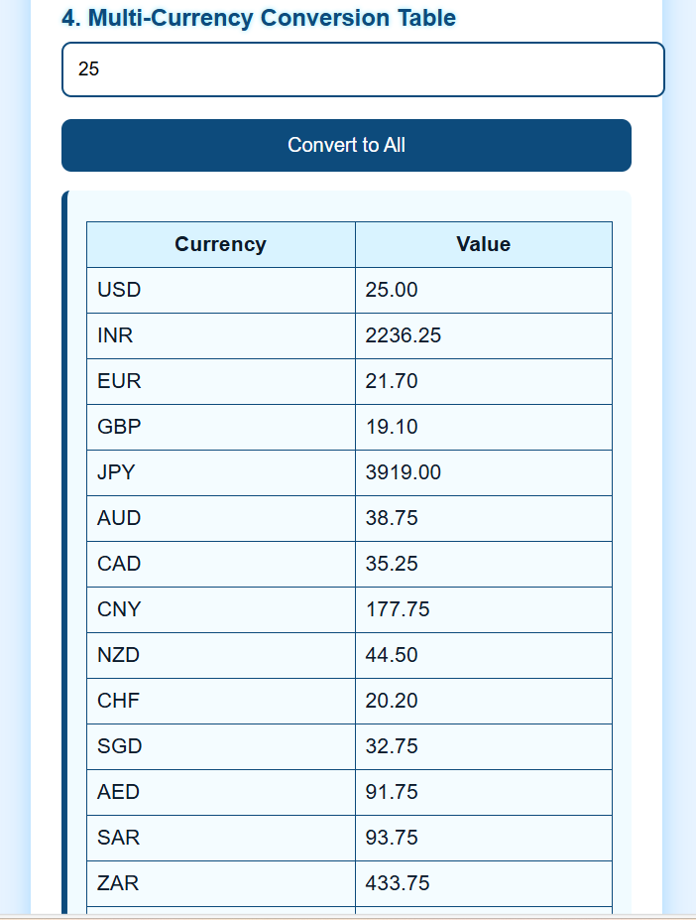
Results and Discussion

Slide 16
Results and Discussion (Cont..)
The Currency Converter Application is a simple and user-friendly tool designed to convert values from one currency to another quickly and accurately. Users can enter an amount, select the source currency, and choose the target currency to get the converted value instantly.
This application currently supports many major currencies:
It provides an efficient and convenient way to check exchange rates and perform conversions for travel, business, or study purposes.
Users can also view the application in dark mode.

Slide 17
Conclusion
The Currency Converter Application provides an efficient, fast, and reliable way to convert between multiple international currencies.
With a simple interface and easy-to-use design, users can quickly obtain accurate conversions among 15+ different currencies along with their flags for easy understanding.
This project demonstrates practical implementation of real-world concepts like data handling, user input processing, and exchange rate calculation, making it useful for both learning and everyday financial needs.

Slide 18
References
Oracle Documentation. Java Platform Standard Edition Documentation. Oracle Corporation.
https://docs.oracle.com/javase/
ExchangeRate-API. Real-Time and Historical Currency Exchange Rates API Documentation.
https://www.exchangerate-api.com/
Pressman, R. S., & Maxim, B. R. (2020). Software Engineering: A Practitioner’s Approach (9th ed.). McGraw-Hill Education.
Schildt, H. (2018). Java: The Complete Reference (11th ed.). McGraw-Hill.
ISO 4217 Standard. Currency Codes — International Organization for Standardization.
https://www.iso.org/iso-4217-currency-codes.html

Slide 19
Thank You
Any queries???

